Slide 1

PPE-Training Staff and Competency Evaluation

Slide 2
At the end of the presentation, the participant will be able to:
List 2 reasons why training staff on the use of PPE is important for infection control.
Describe 2 ways that training can be conducted on use of PPE.
Explain how to perform competency evaluation of staff use of PPE.

Slide 3
SCENARIO: What Would You Do?
Patience, the IP, was making rounds and decided to stop and observe CNAs doffing their PPE after caring for Mrs. Smith. Mrs. Smith is on contact precautions for C. diff.
Sam, a CNA, came out of Mrs. Smith's room wearing his gown and gloves. He then proceeded to reach behind and untie the ties around the waist on his gown. Sam then lifted the gown over his head. He haphazardly bundled the gown up and threw it in a trash can in the hallway. Next, he removed his gloves and discarded them. Patience was feeling very frustrated upon seeing this because she has repeatedly shown Sam the CDC infographic and video on proper PPE removal.
Notes:
Should have discarded PPE in resident's room and then performed HH before leaving room
Gloves should have been removed first.
Untie gown at neck, not over head
Careful bunding and thrown away in resident room
Teaching methods used – any return demonstration – was just visual and auditory – needed hands on.

Slide 4
OSHA Standard 1910.132 Requirements
The employer shall provide training to each employee who is required by this section to use PPE. Each such employee shall be trained to know at least the following:
When PPE is necessary;
What PPE is necessary;
How to properly don, doff, adjust, and wear PPE;
The limitations of the PPE; and,
The proper care, maintenance, useful life and disposal of the PPE.
Each affected employee shall demonstrate an understanding of the training and the ability to use PPE properly, before being allowed to perform work requiring the use of PPE.
Competency testing

Slide 5
OSHA Standard (continued)
When the employer has reason to believe that any affected employee who has already been trained does not have the understanding and skill required, the employer shall retrain each such employee. Circumstances where retraining is required include, but are not limited to, situations where:
Changes in the workplace render previous training obsolete; or
Changes in the types of PPE to be used render previous training obsolete; or
Inadequacies in an affected employee's knowledge or use of assigned PPE indicate that the employee has not retained the requisite understanding or skill.

Slide 6
CMS F945 Training 483.95(e) Infection Control
A facility must include as part of its infection prevention and control program mandatory training that includes the written standards, policies, and procedures for the program as described at §483.80(a)(2). This section falls under F-tag 880.
Standard and transmission-based precautions to be followed to prevent spread of infections
Notes:
When training on standard and transmission-based precautions, PPE education must be included.

Slide 7
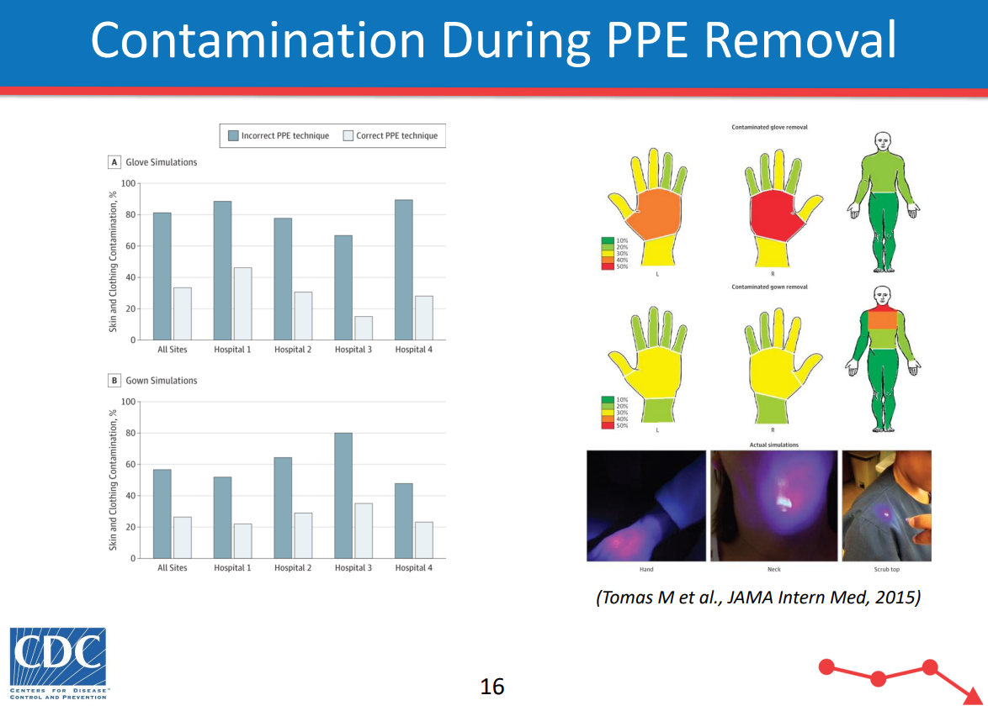
TRAINING
Goals of PPE use are to protect the healthcare worker from germs and prevent transmission of those germs
PPE works when used properly:
Correct fit
Wear the correct PPE (i.e.; wearing eye protection when irrigating an infected wound)
Avoid self-contamination when doffing PPE
PPE (gloves) does not take the place of hand hygiene
Notes:
PPE training should always include the goals of PPE use and the limitations of PPE. PPE only works when used properly – READ SLIDE
Correct fit – PPE that is too small ( for example, a gown that does not cover the healthcare worker’s clothing in the back) leaves that clothing open and exposed to germs.

Slide 8
TRAINING – POLL QUESTION
Which of the following training methods do you use as an IP to train staff on the correct use of PPE? (Select all that apply)
Just-in-time, On-the-job
Accessible information when needed (i.e.; infographics on donning/doffing PPE)
Mobile training – carts, iPad for video viewing
Active – return demonstration
Other – place "other" method used in the CHAT
Notes:
These reflect the different styles of learning
Just-in-time, On-the-job – auditory, 1:1 or group trainings
Accessible information when needed (i.e.; infographics on donning/doffing PPE) - Visual
Mobile training – carts, iPad for video viewing ( visual and kinesthetic)
Active – return demonstration kinesthetic
Other

Slide 9
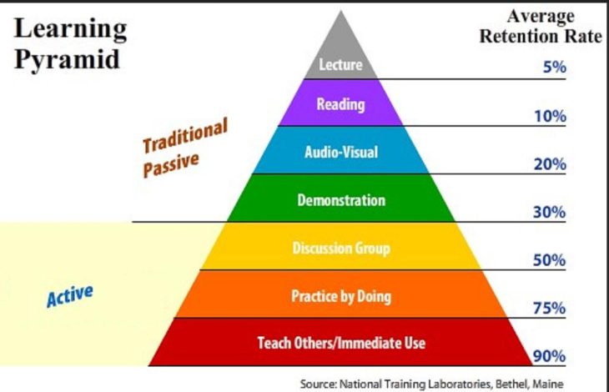
- DEVELOPING TRAINING
Learning Needs Assessment can assist in determining the training needs and to prioritize them
Which employees need training
What training do they need
Who needs it the quickest
Key things to keep in mind when training:
Use a variety of teaching methods ( visual, auditory, kinesthetic)
The more active the training is, the more people retain what they are taught
Notes:
Performing a learning needs assessment can be a good first step when beginning to organize your PPE training. It can help determine the training needs and to prioritize them.
Which employees need PPE training – newly hired staff, agency staff, staff that require remedial training
What training do they need – training on every aspect of PPE, training on use of only one type of PPE such as a N95 respirator
Who needs it the quickest – staff taking care of a resident that has an infection the facility has not had before, based on high risk
Learning styles: people have their own preferences for learning, how they learn best, usually a mixture, learn is change in behavior – if staff behavior doesn’t change, then change the teaching method
Visual – graphs, illustrations , pictures, diagrams PPTs or videos
Auditory- one on one conversations, group discussions, podcasts, videos
Kinesthetic - hands on activities, walking meetings, role playing
REFER BACK TO PREVIOUS SLIDE
The Learning Pyramid shows us that the more active the training is, the more people retain what they are taught. Try incorporating discussion groups, practice by doing and have staff teach each other. Follow the adage: See One-Do One-Teach ONE. GO BACK AND REVIEW SCENARIO

Slide 10
CDC Training Resources
CDC Healthcare Respiratory Protection Resources This website provides healthcare worker respiratory protection resources, including the National Institute for Occupational Safety and Health (NIOSH) toolkit on requirements for an effective hospital respiratory protection program.
Sequence for Donning and Removing Personal Protective Equipment
This poster demonstrates one option for safely donning (putting on) and doffing (removing) PPE.
PPE 103: Training Frontline Health Care Professionals and Auditing Practices [PDF – 45 pages] This training reviews strategies to coach and train frontline health care workers in the use of PPE and strategies for auditing appropriate PPE use to identify gaps and improve PPE adherence. See additional courses at: CDC/STRIVE Infection Control Training.
Notes:
Here are readily available training resources from the CDC.

Slide 11
TRAINING
Practice makes perfect – demonstration and return demonstration
Perform hand hygiene - Simulate contamination using fluorescent glow solution
Don PPE correctly and in the correct order
Doff PPE correctly and without contamination -Simulate contamination using chocolate syrup, etc.
Training is not a one-time occurrence
Annual performance reviews
Audits of staff performance
Individual staff member performance
Notes:
For PPE training, the method most commonly employed is demonstration and return demonstration.
Training of staff is continuous. Deficiencies documented in the annual performance evaluation of an employees may require additional training.
IP and shift coach observations/audits of staff performance may indicate the need for additional training. To a group or individuals
And, individual staff member performance may indicate the need for remedial training

Slide 12
Competency Evaluation
Competency is the ability to do something successfully.
Competency evaluation is when the facility validates that a healthcare worker can perform a task, according to the education and training provided.
Only staff members that have been deemed competent themselves should assess competence.
Competency is NOT assessed via an education module with a post-test.
An education module with a post-test measures knowledge, not competence (or proficiency).
One may be very knowledgeable about a skill, but unable to actually safely perform that skill.
Competency evaluation ensures healthcare workers provide safe, quality care.

Slide 13
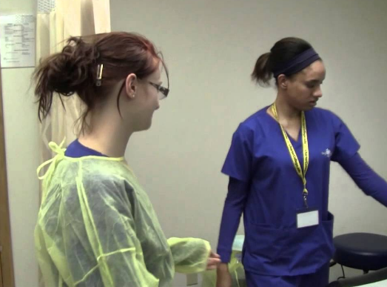
Competency Evaluation
Competency is best assessed via return demonstration and observation.
Additional methods include, but are not limited to:
simulation, role playing and observations during resident care
Performed:
New hire
Annually
Change in type of PPE used in facility
Respirator – staff weight gain/loss affecting fit of respirator
Notes:
Change in type of PPE used in the facility – example – gown which was tied and now using gown that slips over the head and is pulled forward to break the ties.

Slide 14
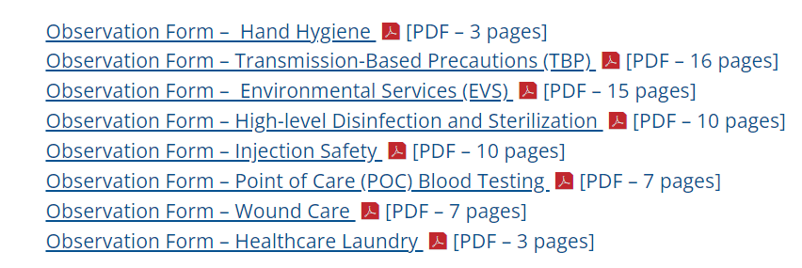
CDC ICAR Observation Forms
CDC Infection Control Assessment and Response (ICAR) Tool for General Infection Prevention and Control (IPC) Across Settings​
Notes:
The CDC includes various observation forms as part of its ICAR process which you can use. The CDC recommends that if an observation tool is being used as part of an in-person assessment, facilitators might consider expanding observations beyond what is listed in this tool.

Slide 15
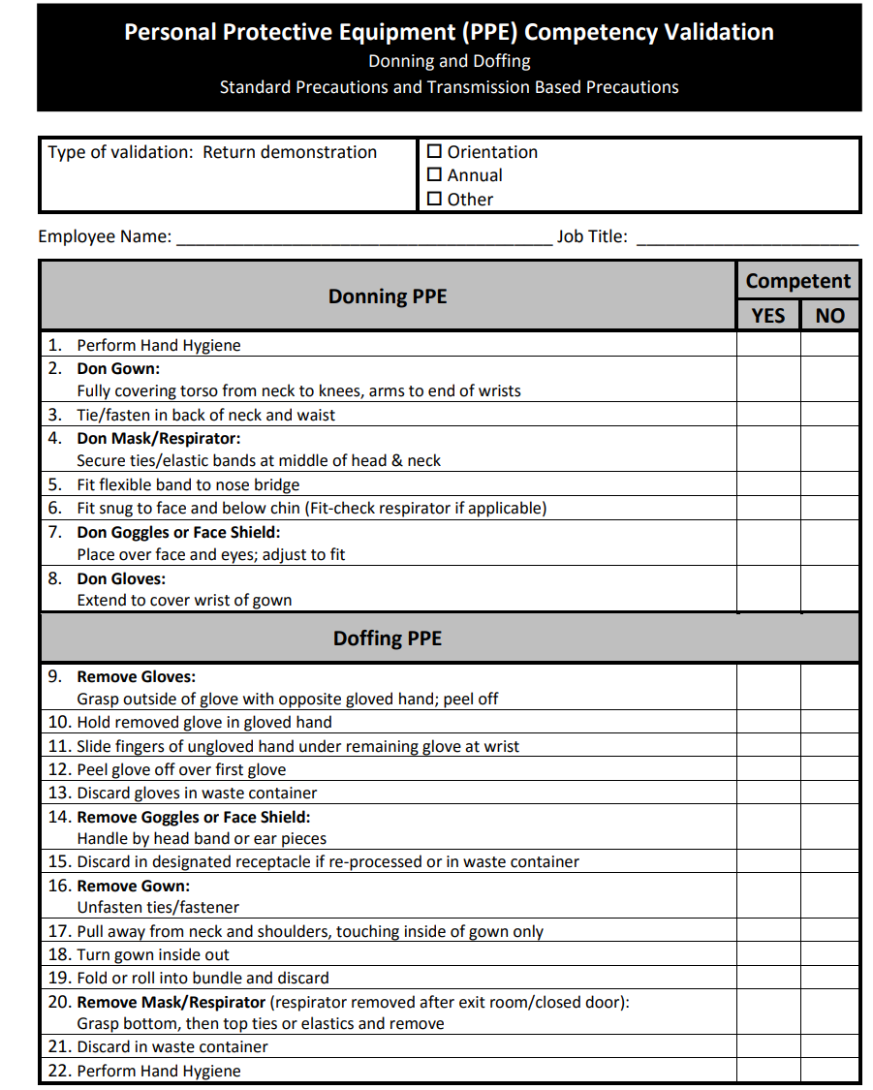
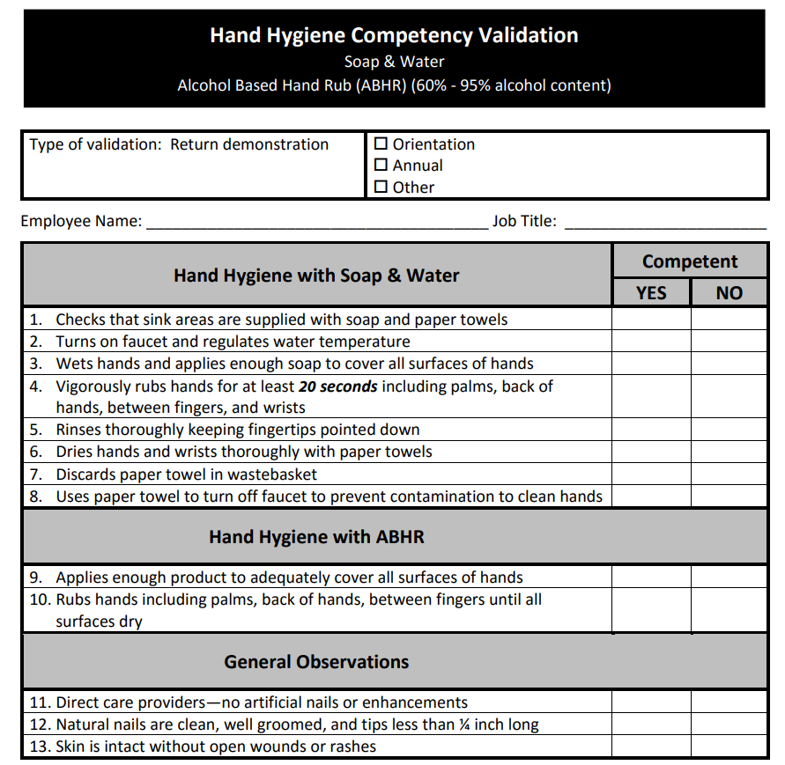
Competency Evaluation Examples
Notes:
On the screen are examples of two competency evaluation forms available through the NC SPICE program. The links for the two competency evaluation forms can be found on the Resources page at the end of the presentation.
There are many competency evaluation forms available from various resources that can be utilized.

Slide 16
Both OSHA and CMS expect facilities to properly train and competency test healthcare workers
PPE training must include the goals and limitations of PPE
Prior to conducting the training, perform a training assessment and determine the best method(s) for training
The more active the training is, the more retention of what was taught occurs
Competency testing ensures staff can correctly perform a task as taught
Training is a continual process
Notes:
The Key Points from today are: READ slide

Slide 17
Discussion
Discuss:
How do you assess the PPE learning needs of staff in your facility?
What training methods do you find most successful?
How is competency testing performed in your facility?
Who performs the testing
How is the testing done
How often is competency testing done

Slide 18
Bleich, Corey, edgepoint learning, “How To Roll Out PPE Training To Your Employees”
CardinalHealth, “The importance of staff training for proper PPE use”, March 22, 2022
CDC Infection Control Assessment and Response (ICAR) Tool for General Infection Prevention and Control (IPC) Across Settings
CDC Occupationally Acquired Infections in Healthcare Settings
CDC, Personal Protective Equipment Course WB 4225:
PPE 103: “Training Frontline Health Care Professionals and Auditing Practices”,
PPE 104: “Auditing and Feedback of PPE Use”

Slide 19
CMS State Operations Manual Appendix PP - Guidance to Surveyors for Long Term Care Facilities
NC SPICE, “Personal Protective Equipment (PPE) Competency Validation” and “Hand Hygiene Competency Validation”​
OSHA Standard 1920.132 General Requirements​
Wound Reference, “Quality of Care Requires Ongoing Competency Evaluations”, February 14, 2022​

Slide 20
Thank You
Building Trust in Long Term Care

